Slide 1
Providing PrEP to adolescents and young adults: current science
Sinéad Delany-Moretlwe, MBBCh PhD
TUSA03, IAS, Amsterdam 2018

Slide 2
Key questions
Does PrEP prevent HIV in young people?
Is it safe for young people to use PrEP?
What are the specific needs of young people when it comes to delivery?

Slide 3
WHO recommends PrEP
PrEP was effective in reducing HIV risk across gender, PrEP regimen, dosing or mode of acquisition
PrEP most effective in studies with high adherence
Age did not moderate the relationship BUT
Lower adherence in < 25 years
WHO, 2015; Fonner, 2018
Notes:
Recommendations based on systematic review of 15 randomised controlled trials of oral PrEP effectiveness conducted in a range of different populations worldwide
Included studies involved 19 491 participants, of whom 11 901 received active PrEP, with follow-up times ranging from 24 weeks to 5 years
PrEP was effective in reducing HIV risk across age, gender, ARV regimen (TDF versus emtricitabine (FTC) + TDF) or mode of acquiring HIV (rectal or penile/ vaginal).

Slide 4
Does PrEP work in young people?
Yes – if taken consistently
…but daily pill taking is a challenge
Source: Hosek, JAMA Pediatrics 2017
Notes:
Similar results were seen in the ATN 110 and 113 studies, Project PrEPare (57). In these studies of young men who have sex with men, ages 15–22, adherence, as measured by drug concentrations, declined over time, with the most precipitous drop-off occurring at week 24, when visits to the facility moved from monthly to quarterly. Early results from the PlusPills Study in Cape Town, which is evaluating PrEP acceptability in male and female adolescents, show a similar drop-off in adherence during quarterly visits (58). In sum, PrEP appears to be of interest to young people, but inattention to adherence or inability to continue may reduce its

Slide 5
Supporting PrEP use in young people
Limited evidence from PrEP field
Contraception | Text messaging Dispensing larger numbers of pill packs
ART | Directly observed therapy Text messaging and reminders Enhanced in-person counselling Financial incentives Adolescent and youth friendly services
Chronic disease | Text messaging Directly observed therapy Motivational interviewing
Strategies being investigated for PrEP include drug level feedback, in person or WhatsApp support clubs or groups, two-way text messaging, intensified follow-up
Source: WHO, 2018

Slide 6
PrEP safety
PrEP was well tolerated
GI side effects (<10%, usually in first month only)
Resistance rare (3%)
Renal function
Changes rare, similar rates in placebo in trials
If changes observed, these are usually reversible
Bone mineral density
Modest changes observed in trials in young men in US and women in SSA, not associated with fractures
Reversible, no additional supplementation required

Slide 7
… recommended for adults and adolescents at risk for HIV-1 infection weighing at least 35 kg…
Recommendation based on trial in 15-17 year olds

Slide 8
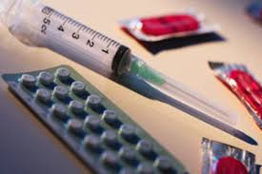
Sexual and reproductive health
PrEP should be offered as part of comprehensive sexual and reproductive health services esp. for young women
No reduction in contraceptive efficacy
No difference in PrEP efficacy in women using DMPA or NET-EN
Pregnancy and lactation
No reason to discontinue PrEP
Minimal breastmilk transfer to infant
No known interactions with exogenous hormones used for feminization/masculinisation
Source: Murnane, 2014; Heffron, 2014; WHO, 2017; Mugwanya, 2016

Slide 9
Sexually transmitted infections
Prevalence of STIs at PrEP initiation among AGYW 16-24 SA, Zimbabwe
Majority of infections are asymptomatic >95%
Source: Celum, CROI 2018

Slide 10
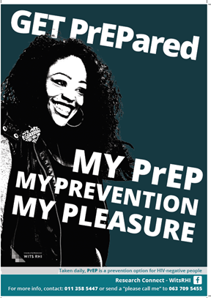
Generating demand
Materials for adolescents should focus on information, being sex positive rather than risk
Decision tools or risk scores may be helpful but should not be used to exclude

Slide 11
Scaling up PrEP services
Youth champion
Advice from youth on service design
Opening hours
Safe space
Integrated
Comprehensive
Pathways for referral
Provider training and support critical
http://sheconquerssa.co.za/roadmaps/are-you-having-sex/sex-roadmaps/

Slide 12
Conclusions
PrEP is effective in young people, although they may require additional support for daily pill taking
PrEP is safe for use in young people
PrEP information for young people and trusted adults is important while PrEP is being introducted
Materials that are sex positive and affirming are important
Non-judgemental, confidential and supportive sexual and reproductive health services that are comprehensive and integrated are essential
Health care providers play a critical role in ensuring access to these services for young people.

Slide 13
Acknowledgements
Connie Celum
Sybil Hosek
Linda-Gail Bekker
Shona Dalal
Bill Kapogiannis
Young PrEP users
Their families and communities
Colleagues in SA PrEP TWG

